Slide 1

Introduction to Reactive Programming, build
Non-Blocking
clients using WebClient
Java Full Stack Program

Slide 2
What Is Reactive Programming?
Reactive Programming has become very popular of late, and with good reason.
Simply put, it’s a non-blocking alternative to traditional programming solutions, working entirely with event driven data streams and functional programming concepts to manipulate these streams. It is a way to allow data changes in one part of the system to automatically update other parts of the system and to do so with minimal cost to ourselves.
As reactive streams are non-blocking, the rest of the application doesn’t have to be waiting while the data is being processed. This helps to allow reactive servers to scale significantly further beyond more traditional implementations because the worker threads in the application are not tied up waiting for other resources – they’re typically free to handle more incoming requests.
Java Full Stack Program

Slide 3
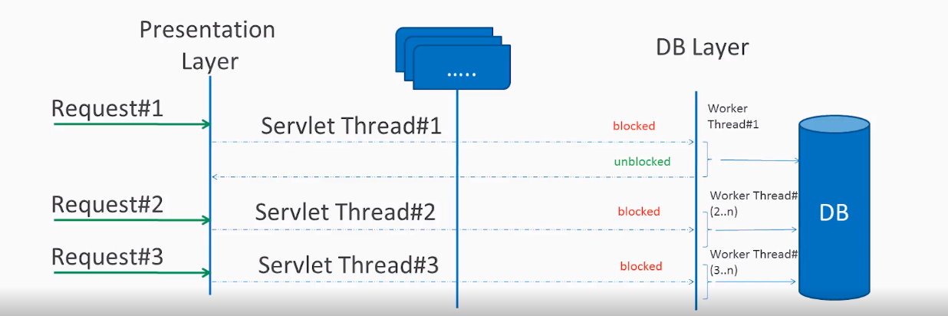
Blocking vs Non-blocking (Async) Request Processing
Blocking Request Processing
In traditional MVC applications, a new servlet thread is created when a request comes to the server. It delegates the request to worker threads for I/O operations such as database access etc. During the time worker threads are busy, the servlet thread (request thread) remains in waiting status, and thus it is blocked. It is also called synchronous request processing.
Java Full Stack Program

Slide 4
As a server can have some finite number of request threads, it limits the server’s capability to process that number of requests at maximum server load. It may hamper the performance and limit the full utilization of server capability.
Non-blocking Request Processing
In non-blocking or asynchronous request processing, no thread is in waiting state. There is generally only one request thread receiving the request.
All incoming requests come with an event handler and callback information. Request thread delegates the incoming requests to a thread pool (generally a small number of threads) which delegates the request to its handler function and immediately starts processing other incoming requests from the request thread.
Java Full Stack Program

Slide 5
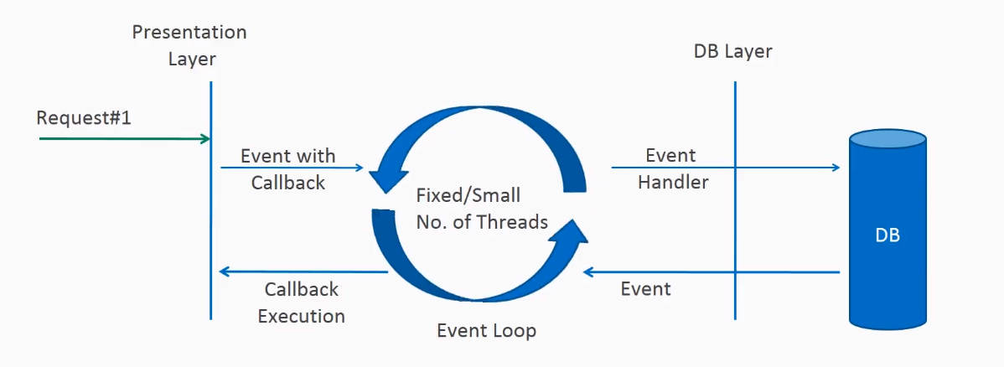
When the handler function is complete, one thread from the pool collects the response and passes it to the call back function.
Non-blocking request processing
Java Full Stack Program

Slide 6
Non-Blocking clients using WebClient
Maven
To use WebClient api, we must have spring-boot-starter-webflux module imported into the project.
<dependency>
<groupId>org.springframework.boot</groupId>
<artifactId>spring-boot-starter-webflux</artifactId>
</dependency>
Java Full Stack Program

Slide 7
Creating Spring WebClient
To create WebClient bean, we can follow any one of the given approaches.
Using WebClient.create()
The create() method is an overloaded method and can optionally accept a base URL for requests.
WebClient webClient1 = WebClient.create(); //with empty URI
WebClient webClient2 = WebClient.create("https://client-domain.com");
Java Full Stack Program

Slide 8
Using WebClient.Builder API
We can also build the client using the DefaultWebClientBuilder class, which uses builder pattern style fluent-API.
WebClient webClient2 = WebClient.builder()
.baseUrl("http://localhost:3000")
.defaultCookie("cookie-name", "cookie-value")
.defaultHeader(HttpHeaders.CONTENT_TYPE, MediaType.APPLICATION_JSON_VALUE)
.build();
Java Full Stack Program

Slide 9
Sending HTTP Requests
To send a request, we can use its fluent API and execute the necessary steps as per requirements. For example, sending an HTTP POST request involves the following steps.
Create WebClient.UriSpec reference using method(HttpMethod) or prebuilt methods such as get(), put(), post() or delete().
Set the request URI if not set already.
Set the request headers and authentication details, if any.
Set the request body, if any.
Call the retrieve() or exchange() method. The retrieve() method directly performs the HTTP request and retrieves the response body. The exchange() method returns ClientResponse having the response status and headers. We can get the response body from ClientResponse instance.
Handle the response returned from the server.
Java Full Stack Program

Slide 10
WebClient webClient = WebClient.create("http://localhost:3000");
Employee createdEmployee = webClient.post()
.uri("/employees")
.header(HttpHeaders.
CONTENT_TYPE, MediaType.APPLICATION_JSON_VALUE)
.body(Mono.just(empl), Employee.class)
.retrieve()
.bodyToMono(Employee.class);
Handling API Response
If we want to get only the response body then using methods retrieve() and then use the bodyToFlux() and bodyToMono() methods.
Java Full Stack Program

Slide 11
....retrieve().bodyToMono(Employee.class);
Please note that bodyToMono() and bodyToFlux() methods always expect a response body of a given class type. If the response status code is 4xx (client error) or 5xx (Server error) i.e. there is no response body then these methods throw WebClientException. Use bodyToMono(Void.class) if no response body is expected.
Java Full Stack Program

Slide 12
Spring WebClient Examples
GET API Example
Generally, we will use GET API to fetch either collection of resources or a singular resource. Let’s see the example of both use cases using get() method call.
HTTP GET /employees : collection of employees as Flux
HTTP GET /employees/{id} : single employee by id as Mono
POST API Example
POST API is commonly used for creating a resource. Let’s see an example of post() method to create an employee.
HTTP POST /employees : creates a new employee from request body and returns the created employee in response.
Java Full Stack Program

Slide 13
PUT API Example
PUT API is commonly used for updating a resource. Let’s see an example of put() method to update an employee.
HTTP PUT /employees/{id} : updates an existing employee data from the request body and returns the updated employee in response.
DELETE API Example
DELETE API is commonly used for deleting a resource. Let’s see an example of delete() method to delete an employee from records.
HTTP DELETE /employees/{id} : deletes an existing employee by its id. It does not accept any request body as well as does not return any response body as well.
Java Full Stack Program

Slide 14
Useful Configurations
Configuring Memory Limit
Spring WebFlux configures the default memory limit for buffering data in-memory to 256KB. If this limit is exceeded in any case then we will encounter DataBufferLimitException error.
To reset the memory limit, configure the below property in application.properties file.
spring.codec.max-in-memory-size=1MB
Java Full Stack Program

Slide 15
Configuring Connection Timeouts
We can use HttpClient class to set timeout periods for connection timeout, read timeout and write timeouts.
public WebClient getWebClient()
{
HttpClient httpClient = HttpClient.create()
.tcpConfiguration(client ->
client.option(ChannelOption.CONNECT_TIMEOUT_MILLIS, 10000)
.doOnConnected(conn -> conn
.addHandlerLast(new ReadTimeoutHandler(10))
.addHandlerLast(new WriteTimeoutHandler(10))));
ClientHttpConnector connector = new ReactorClientHttpConnector(httpClient);
return WebClient.builder()
.baseUrl("http://localhost:3000")
.clientConnector(connector)
.defaultHeader(HttpHeaders.CONTENT_TYPE, MediaType.APPLICATION_JSON_VALUE)
.build();
}
Java Full Stack Program

Slide 16
THANK YOU
Java Full Stack Program

